Slide 1
SIMAC Hydraulic 2
Basic Hydraulic - Systems

Slide 2
Basic Hydraulic Hydraulic Systems
Hydraulic system
Characteristics
Energy conversion
Design of simple hydraulic system
Further devices (tank, filter etc.)

Slide 3
Basic Hydraulic Hydraulic system - Characteristic
Transfer large forces at relative small unit volumes
Step-less adjustment of speed, torque, force
Simple protection against overloading
Suitable for both quick an very slow movements
Storage of energy with gases
Simple central drive system available
Decentralized conversion of hydraulic energy into mechanical energy is possible
Notes:
The charitaristic of a hydraulic system is…
It can:

Slide 4
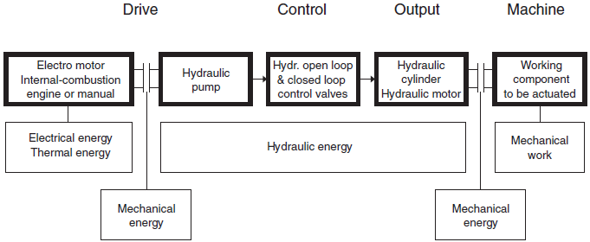
Basic Hydraulic Hydraulic system - Energy
Notes:
The energy flow in a hydraulic system
In hydraulic systems mechanical energy is converted to hydraulic energy, then transported, and coverted back to mechanical energy.

Slide 5
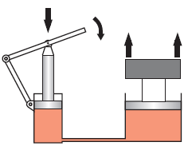
Basic Hydraulic Hydraulic system – Design of simple hydraulic system
Notes:
When the hand pump is released the load on will bee lowered again.
Area of circle A=(pi/4)*d²
Ask class to calculate an excample
d1=5
d2 =10 cm
m1 = 50 kg
=> m2 200 kg (m1/[d1^2/d2^2] = 50/0.25=200)

Slide 6
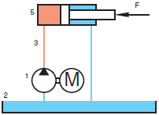
Basic Hydraulic Hydraulic system – Design of simple hydraulic system
Notes:
We can exchanges the hand pump with a hydraulic pump driven by an electrical motor.
When the electrical driven pump is stopped the load on the cylinder will press the oil backwards in the system and therefore the pump will now act as a motor.
Hydraulic pump
Tank
5) Hydraulic cylinder
In order to be able to stop the pump we must build aditional devices into the system

Slide 7
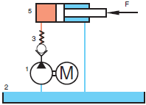
Basic Hydraulic Hydraulic system – Design of simple hydraulic system
Notes:
Check Valve
Hydraulic pump
Tank
Check valve
Hydraulic cylinder
By installing the check valve it is now possible to stop the cylinder in any given position by stopping the pump.
If the cylinder goes fully plus and the pump is not stopped the system will be damaged.
In order to be able to protect the system we must build in a aditional device

Slide 8
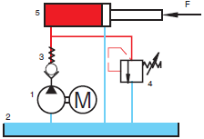
Basic Hydraulic Hydraulic system – Design of simple hydraulic system
Notes:
Pressure relief valve
Hydraulic pump
Tank
Check valve
Pressure relief valve
Hydraulic cylinder
To protect the system a pressure relief valve is installed
We can only control the system by starting and stopping the pump, this will not be sutable in practic so further devices must be build into the system

Slide 9
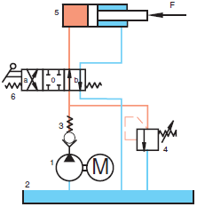
Basic Hydraulic Hydraulic system – Design of simple hydraulic system
Notes:
Directional Control valve 4/3 way
Hydraulic pump
Tank
Check valve
Pressure relief valve
Hydraulic cylinder
Directional Control valve 4/3 way
It is now possible to operate the cylinder I both directions, and the system is protected against damage if the pump builds up the pressure due to the cylinder is fully extended.
The speed of the cylinder is only controled by the displacement of the pump… To be able to change the piston speed we have to install further devices into the system.

Slide 10
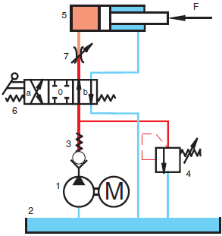
Basic Hydraulic Hydraulic system – Design of simple hydraulic system
Notes:
Flow control valve
Hydraulic pump
Tank
Check valve
Pressure relief valve
Hydraulic cylinder
Directional Control valve 4/3 way
Flow control valve
In order to change the speed of the cylinder movement, a flow control valve is installed.
- Pressure p₁ between pump and flow control valve (7) is dependent of the opening pressure of the pressure relief valve (4)
- Pressure p₂ between flow control valve (7) and cylinder is dependen of the load
The basic hydraulic system is now ready for operation, but be aware that this system is only a simplified system that will not be suitable to install in practic.

Slide 11
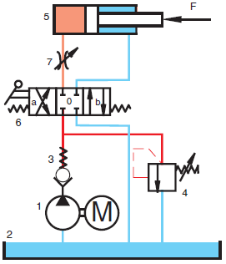
Basic Hydraulic Hydraulic system – Design of simple hydraulic system
Notes:
Hydraulic pump
Tank
Check valve
Pressure relief valve
Hydraulic cylinder
Directional Control valve 4/3 way
Flow control valve
The final hydraulic system is always drawn as shown with the directional control valve in the initial possition.

Slide 12
Basic Hydraulic Hydraulic system – Further devices
In order to store and take care of the pressure fluid, a series of additional devices are necessary, such as tank, filter, cooler, heating element, and measurement and testing devices.
Beside the above mentions devices some systems is also fitted with accumulators.
Notes:
Additional devices are needed to encure a realiable hydraulic system that can be installed in rough envirements fx. An oil rig.

Slide 13
Basic Hydraulic System - More information
Video
Hydraulic introduction 03:25 AVSEQ01
Energy conversion 01:18 AVSEQ07
Notes:
01 03:25 Intro til hydr., fordele, flere forskellige maskiner,
gravemaskine, elevator, presse, autolift
07 01:18 Mekanisk energi omformes til hydr. energi, autolift
power unit, power control section, drive unit (cyl.)

