Slide 1
SIMAC Hydraulic 2
Basic Hydraulic – Directional Control Valves

Slide 2
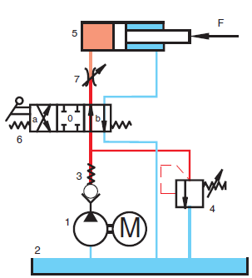
Basic Hydraulic
Directional Control Valves
Notes:
All valves which are used to control the start, stop and change direction of flow of a pressure medium are called “directional control valves”

Slide 3
Basic Hydraulic
Directional Control Valves
Directional control valves
  Naming
  Design types
  Performance
  Directional spool valves
    Electrical control
    Mechanical, manual operation
  Directional poppet valves
Proportional valves

Slide 4
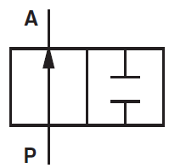
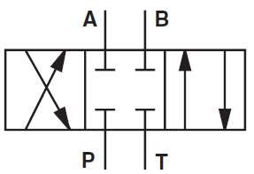
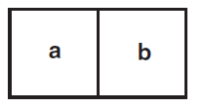
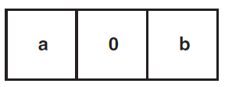
Basic Hydraulic
Directional Control Valves - Naming
2 /2 Way directional control valve
4/3 Way directional control valve
2 Way – Neutral position either “a “or “b”
3 Way – Neutral position “0”
Notes:
The designation of a directional control valve refers to the number of working ports and the number of spool positions.
P = Pressure port
T = Tank port (drain port)
A,B = Working port
A valve with 2 positions the neutral position is designated as either a or b depending on the position.
A valve with 3 or more positions the neutral position is designated with a “0”

Slide 5
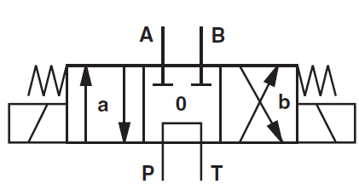
Basic Hydraulic
Directional Control Valves - Naming
Notes:
The directional control valve shown is a spring centered 4/3 directional control valve with electrical activation
The designation of a directional control valve refers to the number of working ports and the number of spool positions.
P = Pressure port
T = Tank port (drain port)
A,B = Working port
A valve with 2 positions the neutral position is designated as either a or b depending on the position.
A valve with 3 or more positions the neutral position is designated with a “0”

Slide 6
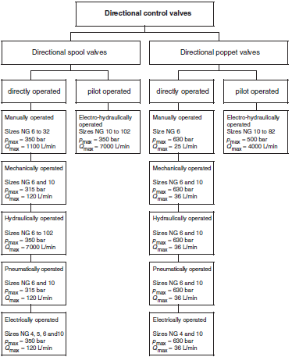
Basic Hydraulic
Directional Control Valves – Design types
Notes:
We define the directional control valves by their design types.
Spool valve= cylinder der glider
Poppet valve = kegle ventil
As seen on the diagram the spool types work with lower pressure that the poppet type, but the flow rate is much higher that corresponding poppet types
Function and characteristic of directional control valves

Slide 7
Basic Hydraulic
Directional Control Valves – Performance
The performance and quality of a directional control valve is determined on the basis of the following criteria:
Dynamic power limit
Static power limit
Resistance to flow
Leakage (in directional slide valves)
Switching time
Notes:
Dynamic performance limit
The product of flow and operating pressure is the dynamic power limit (X-axis flow, Y-axis pressure drop).
The power limits may be a function of the control spring, the solenoid or control pressure. Depending of the type of the spool, one of these 3 parameters determines the power limit of the valve. The acting force must be able of overcome the spring force and the axial force created in the valve. The spring force on its own must be capable of returning the spool against the axial force to its initial position.
Static performance limit
Is very dependent on the effective time of the operating pressure. For how long can the valve work at the actual system pressure.
This is of course dependent on the system temperature, pressure, dirt amount, water in oil amount (oil quality) etc.

Slide 8
Basic Hydraulic
Directional Spool Valves
The directional spool valve is the most common one used due to its many advantages, such as:
Simple construction
Good pressure compensation, hence low acting forces
High switching power
Low losses
Variety of control functions

Slide 9
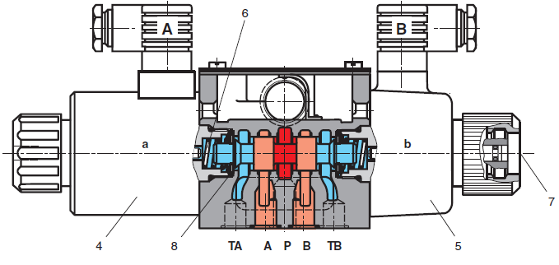
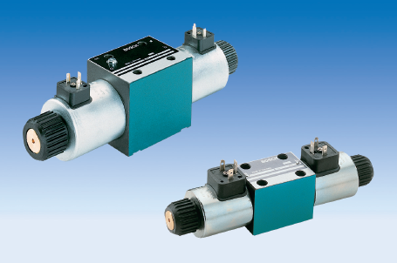
Basic Hydraulic
Directional Spool Valves – Electrical control
Notes:
A electrical controlled spool directional control valve.
When spool moves to the right:
Port P is connected to port B and port A is connected to port TA
When spool moves to the left:
Port P is connected to port A and port B is connected to port TB
The electrical control can either be a DC or AC coil.
Draw the valve symbol on the whiteboard (4/3 way valve)

Slide 10
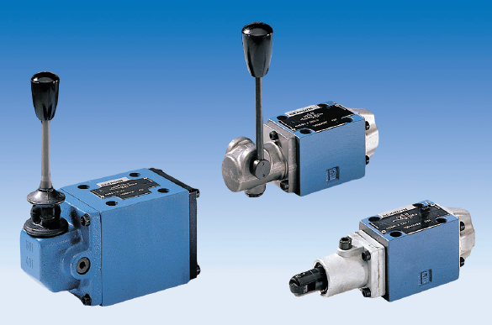
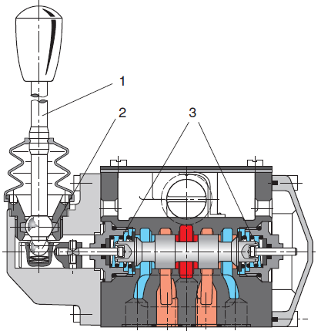



Basic Hydraulic
Directional Spool Valves – Mechanical, manual operation
Notes:
4/3 way directional control valve
Operation: Hand lever with detent in positions a, 0 and b
4/2 way directional control valve
Operation: Hand lever to a, spring return to b
4/2 way directional control valve
Operation: roller tappet to a, spring return to b

Slide 11
Basic Hydraulic
Directional Poppet Valves
The main features of directional poppet valve are:
No leakage
Long life time, due to no leakage
May be used with very high pressures (1000 bar)

Slide 12
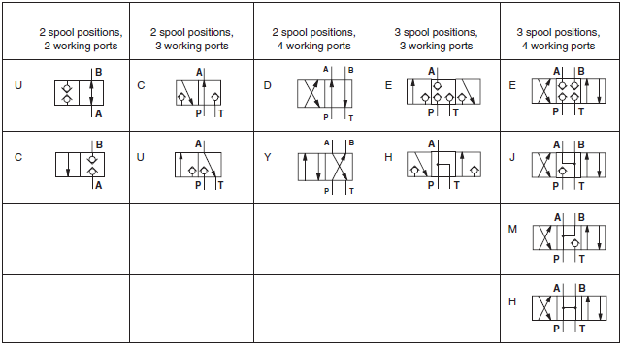
Basic Hydraulic
Directional Poppet Valves
Notes:
There is no distinction made between the symbols for directional spool and directional poppet valves according to DIN ISO 1219. However, in practice it has been found useful to make a distinction between the two. As shown above the closing element of directional poppet valves are represented by check valves.

Slide 13
Basic Hydraulic
Directional Proportional Valves
Hydraulic valves that are electrically operated by proportional solenoids are classified as proportional valves.
Control direction and the amount of fluid flow or control the amount of pressure within a system.
Especially useful in situations where system speed must be tightly controlled.
Provides precise control in applications where hydraulic pressure must be built up steadily
Notes:
Hydraulic valves that are electrically operated by proportional solenoids are classified as proportional valves.
Proportional Control Valves are controlled by electronic Amplifier control boards, and are commonly called electro-hydraulics. These Proportional Valves control direction and the amount of fluid flow or can control the amount of pressure within a system.
Electro-hydraulic controls are especially useful in situations where system speed must be tightly controlled, or where ramping up and down is needed to avoid sudden starts or stops. Electro-hydraulics also provides precise control in applications where hydraulic pressure must be built up steadily.

Slide 14
Basic Hydraulic
Directional control valves - More information
Video
  Directional control valves 10:43
  AVSEQ11
Notes:
11 10:43 Retningsventiler, animationer af: 2/2, 3/2 (+ autolift)
4/2 (med double acting cyl.) 4/3 (+ motor), forskellige
center positioner, switching overlap (07:00), 3/2 og
4/3 differentialkobling

Slide 15
Basic Hydraulic
Exercise - Automation Studio
  Exercises
    Exercise 6.1 – Directional control valve
Notes:
F=p•A F=m•g

