Slide 1
SIMAC Hydraulic 3
Basic Hydraulic – Hydraulic Fluid

Slide 2
Basic Hydraulic Hydraulic Fluid
Function of hydraulic oil
Characteristics of hydraulic oil properties
Oil types and applications
Storage, handling and transfer

Slide 3
Basic Hydraulic Function of hydraulic oil
Power transmission
Lubrication
Cooling
Sealing
Carrier for contaminations

Slide 4
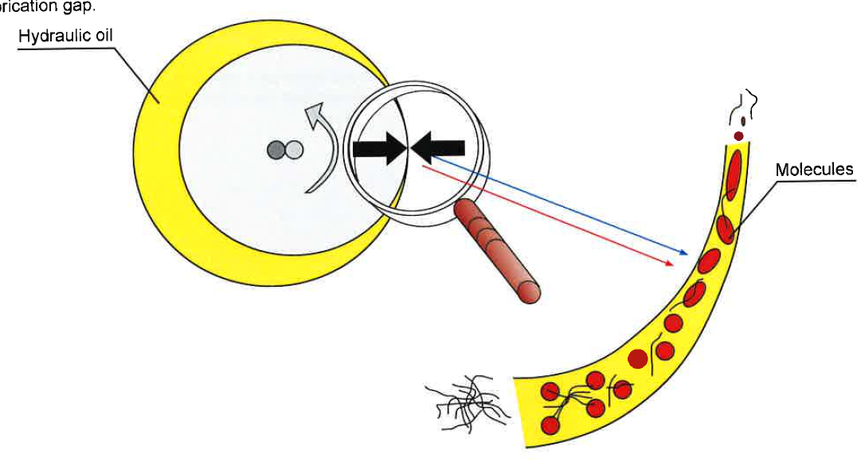
Basic Hydraulic Characteristics of hydraulic oil
Viscosity
Notes:
Charateristics and properties and their effect on system performance.
Viscosity
Discribes the property of fluids to resist deformation from a static state and is therefore a measurement of the inner friction of the oil as it flows. Cold oil has a greater inner friction (high viscosity). The warmer the oil becomes, the lower the inner friction (low viscosity).
Viscosity index
Lubricity
Oxydation
Pour point
Demulsibility
Material compability

Slide 6
Basic Hydraulic Regenerative Circuit
If a force acts perpendicularly to a surface, then the force F divided by the area of the surface A is the pressure p.
Notes:
Explain the equation and give an example on the whiteboard
- Man with a weight of 100 kg will resulte in a Force of 9.81x100=981 N
- If we place the man on top of a cylinder with a diameter of 20 mm the pressure would be
A= (pi/4)*d² = (3.14/2)*0.020 = 0.015
p=98.1/0.015² = 397584 PA = 3.97 bar
1 bar = 14.50 PSI (pounds per square inch)
p_{PSI} = 3.97*14.50= 58 PSI
In practice it is general adequate to use g=10N = 1dN

Slide 7
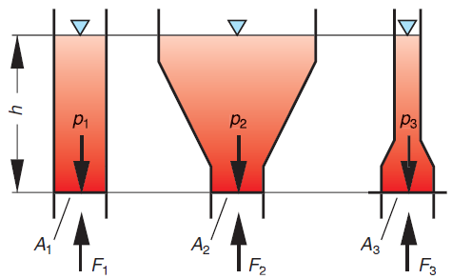
Basic Hydraulic Electrical symbols
Notes:
Witch force is the greatest due to the amout of oil?
They are equal due to the same pressure hight of the fluid, even though the amount of fulied is not the same (volume = mass)
The pressure is the same due to p=rho*g*h
rho= density
that means that p*A₁ is equal to p*A₂ and to p*A₃ so F1=F2=F2
even though the amaount of fluid isn’t the same in the containers

Slide 8
Basic Hydraulic Laboratory exercises
“The effect of a force acting on a stationary fluid spreads in all directions within the fluid. The amount of pressure in the fluid is equal to the weight force, with respect to the area being acted upon. The pressure always act at right angles to the limiting surface of the container”
Notes:
Pascal found that…Pressure due to external forces…
Weight force = m*g

Slide 9
Basic Hydraulic Circuitry and control - More information
Video
Pascal’s Law 02:45 AVSEQ03
Force balance 01:40 AVSEQ04
Flow velocity 02:15 AVSEQ06
Notes:
03 02:45 p=F/A, Pascals lov, cylinderhastighed vs. flow, Q=V/t
eksempel med cyl. hast. ved forskellige flow
04 01:40 To stempler med lodder på, kraftbalance, arealforhold,
donkraft
06 02:15 Forskellige rørtværsnit => forskellige hastigheder,
laminært flow, trykfald i indsvævringer, kavitation,
billede af kaviteret komponent, gennemsigtige
komponenter, dieseleffekt

