Slide 1
SIMAC Hydraulic 2
Automation Studio
Introduction

Slide 2
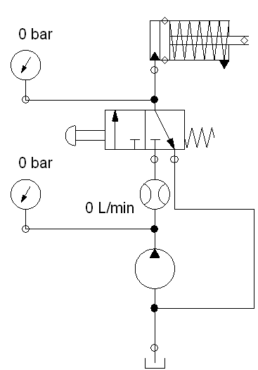
Hydraulic circuit
Design hydraulic circuit
Simulate hydraulic
Simulate electro hydraulic
Measurements

