Slide 1
SIMAC Hydraulic 2
Welcome to SIMAC
Instructors:
Svend-Erik Reher
Søren Nyborg Hansen
Cours manager:
Bo Jensen
Course Administrator:
Mette Mazur

Slide 2
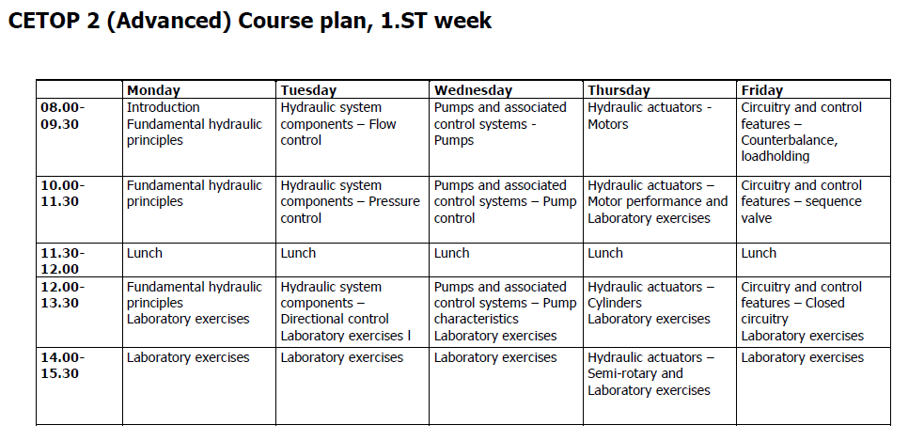
SIMAC Hydraulic 2 Course Plan

Slide 3
Who are you
Hydraulic experience
Your job
What Rig
Your expectations to Hydraulic 2

