Slide 1
SIMAC Hydraulic 2
Welcome to SIMAC
Instructors:
Allan Juhl Larsen
Søren Nyborg Hansen
Cours manager:
Bo Jensen
Course Administrator:
Mette Mazur

Slide 2
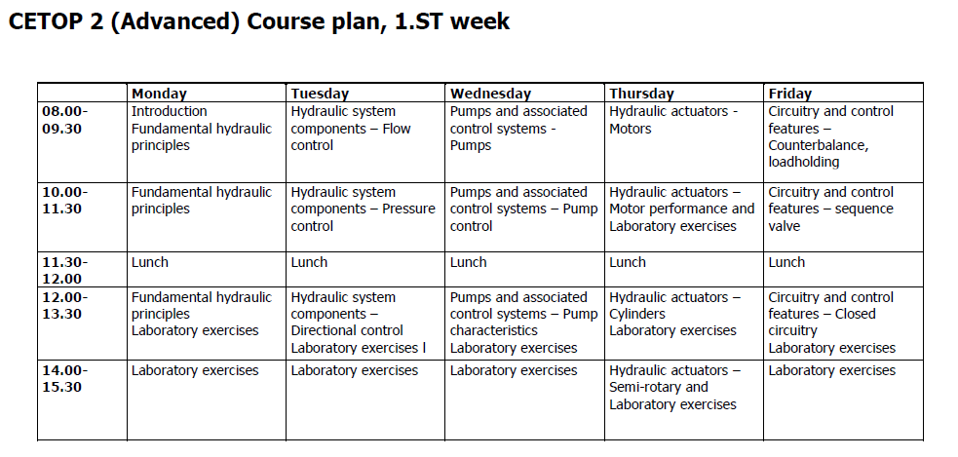
SIMAC Hydraulic 2
Course Plan

Slide 3
Who are you
  Hydraulic experience
  Your job
  What Rig
  Your expectations to Hydraulic 2

